Slide 1
Geo-blocking and EU competition law
Thomas Kramler DG Competition, European Commission
(The views expressed are not necessarily those of the European Commission)

Slide 2
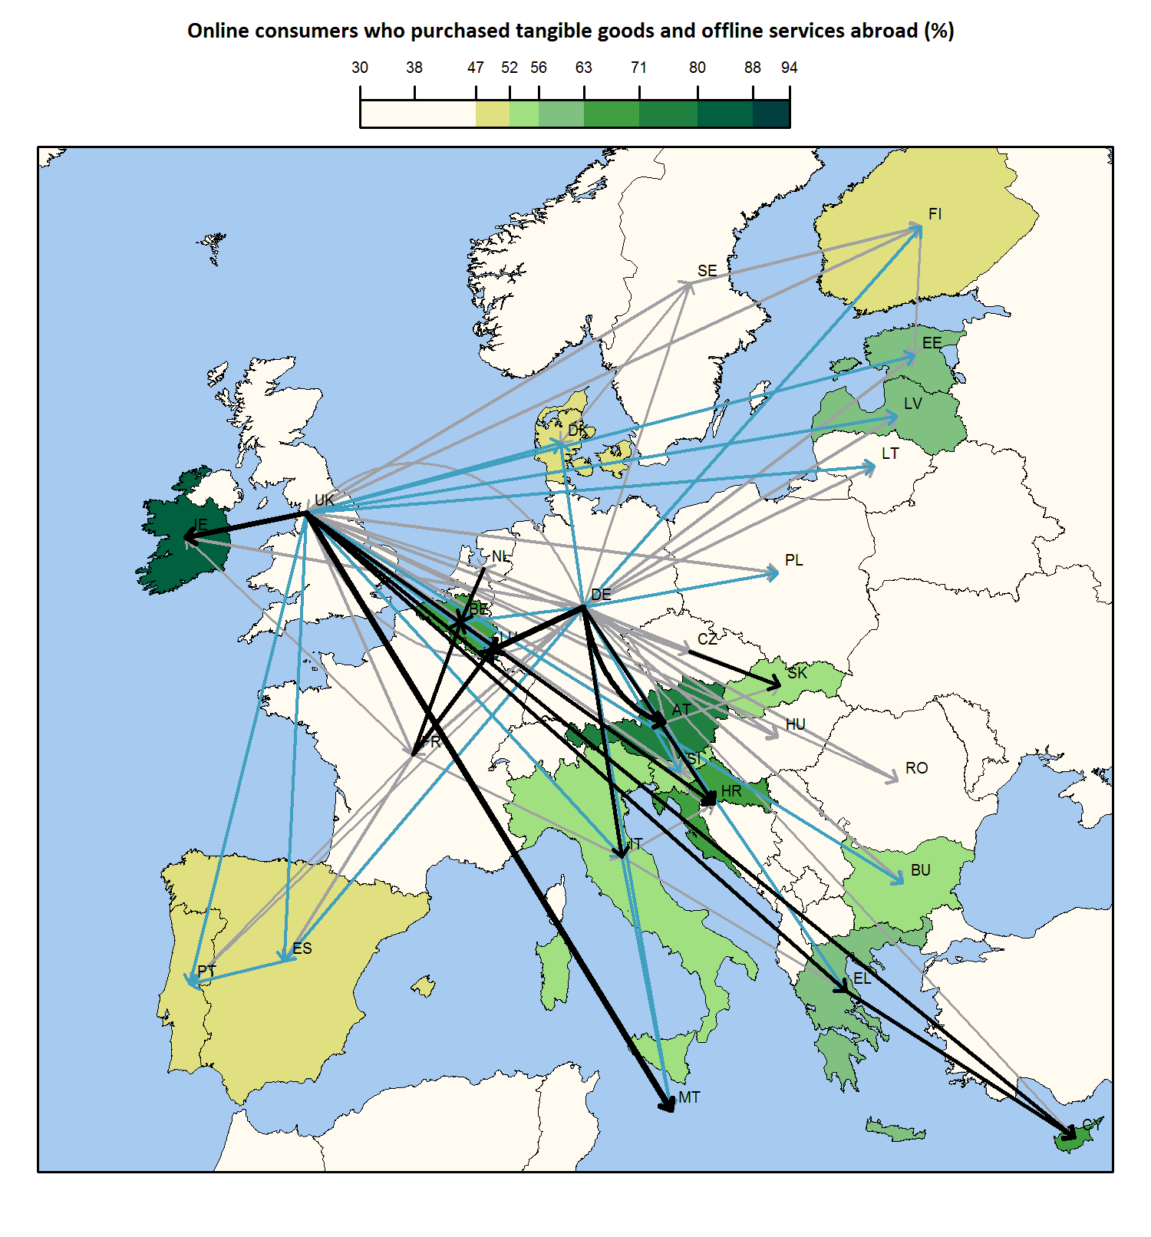
e-Commerce in the EU

Slide 3
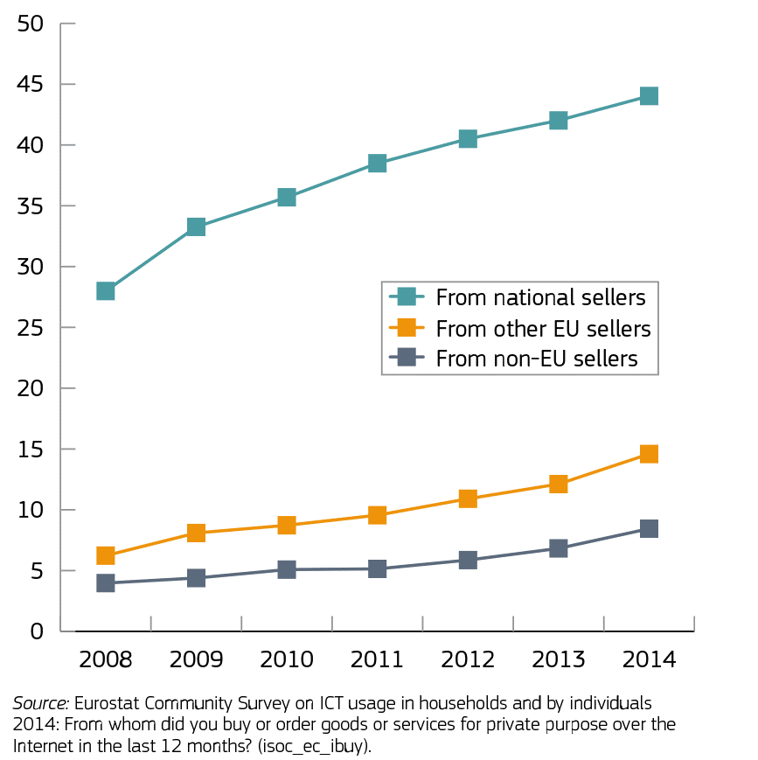
Domestic and cross-border online shopping, EU 28, 2008-2014 (% of population who ordered goods or services over the Internet, domestically and cross-border, in the last 12 months)

Slide 4
The Single Market Objective
ECJ, Joined Cases C‑403/08 and C‑429/08, Murphy, paragraph 139:
"An agreement which might tend to restore the divisions between national markets is liable to frustrate the Treaty’s objective of achieving the integration of those markets through the establishment of a single market. Thus, agreements which are aimed at partitioning national markets according to national borders or make the interpenetration of national markets more difficult must be regarded, in principle, as agreements whose object is to restrict competition within the meaning of Article 101(1)."

Slide 5
Geo-blocking
Geo-blocking prevents users from accessing/purchasing consumer goods/digital content services online based on location/place of residence
Geo-filtering refers to different terms (in particular prices) depending on the location/place of residence
Personalised pricing refers to different prices on the basis of user data

Slide 6
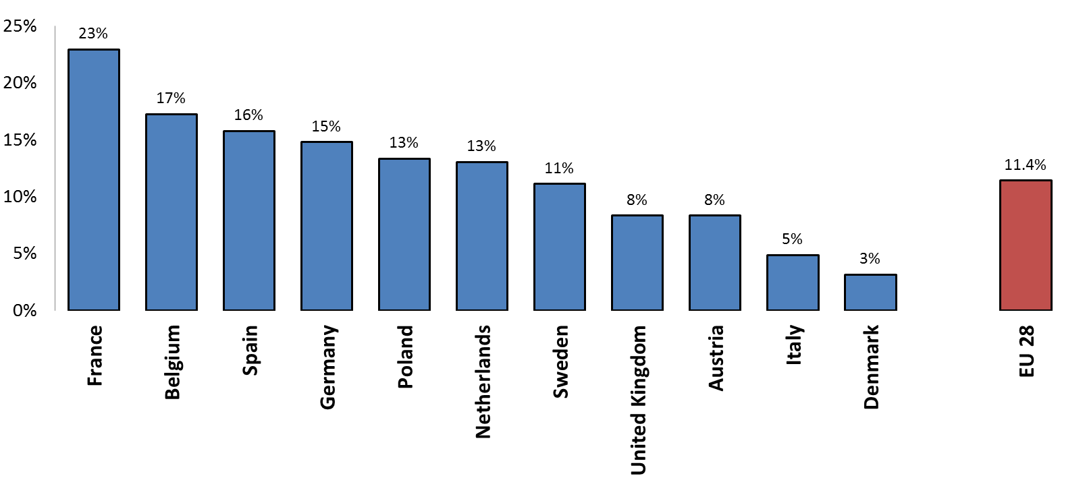
Cross-Border Sales Restrictions (Goods)
B. 53: Retailers that have contractual restrictions to sell cross-border in at least one product category, by Member State

Slide 7
Delivery refusal most common geo-blocking measure
B. 47: Retailers that gather location information for each geo-blocking purpose – EU 28
Notes:
Slides
Font: Verdana
Font sizes:
Heading: 44
First level bullet points: 32
Second level bullet points: 28
Do not use third level bullet points
Notes
Do not have to be full sentences.
Should expand on the points in the slides and provide background information.
Font size: 14
If there is too much text to fit on a page (View… NotesPage), then put ALL notes for the presentation in a separate Word document, with notes for each slide starting on a new page.

Slide 8
Contractual Geo-Blocking (Digital Content)
C. 42: Proportion of agreements requiring providers to geo-block by category – Average for all respondents – EU 28

Slide 9
Implementation of Geo-Blocking
C. 39: Technical measures used to implement geo-blocking – Average proportion of all respondents – EU 28

Slide 10
Absolute territorial protection and IP
Trade Marks: ECJ, Cases 56 and 58/64, Consten & Grundig
Plant breeders rights: ECJ, Case 258/78, Nungesser
Patents: Article 4(2)(b) TTBER

Slide 11
Absolute territorial protection and IP
Copyright: ECJ, Case 262/81, Coditel II:
"A contract whereby the owner of the copyright for a film grants an exclusive right to exhibit that film for a specific period in the territory of a Member State is not, as such, subject to the prohibitions contained in Article 85 of the Treaty. It is, however, where appropriate, for the national court to ascertain whether, in a given case, the manner in which the exclusive right conferred by that contract is exercised is subject to a situation in the economic or legal sphere the object or effect of which is to prevent or restrict the distribution of films or to distort competition on the cinematographic market, regard being had to the specific characteristics of that market."

Slide 12
Absolute territorial protection and IP
Copyright: ECJ, Joined Cases C‑403/08 and C‑429/08, Murphy, paragraphs 140-142:
"140 […] where a licence agreement is designed to prohibit or limit the cross-border provision of broadcasting services, it is deemed to have as its object the restriction of competition, unless other circumstances falling within its economic and legal context justify the finding that such an agreement is not liable to impair competition.
141 […] the actual grant of exclusive licences for the broadcasting of Premier League matches is not called into question. Those proceedings concern only the additional obligations designed to ensure compliance with the territorial limitations […] namely the obligation on the broadcasters not to supply decoding devices enabling access to the protected subject-matter with a view to their use outside the territory covered by the licence agreement.
142 Such clauses prohibit the broadcasters from effecting any cross-border provision of services that relates to those matches, which enables each broadcaster to be granted absolute territorial exclusivity in the area covered by its licence and, thus, all competition between broadcasters in the field of those services to be eliminated."

Slide 13
Commission workstreams on Geo-blocking
Enforcement:
Pay-TV cases ongoing (Paramount commitments, July 2016)
Opening of proceedings: Geo-blocking practices in PC videogames (February 2017)
Legislative initiatives:
Portability regulation (agreed)
Geo-blocking regulation (ongoing)

Slide 14
Conclusion
Geo-blocking is an old issue in new disguise
Territorial vertical restrictions have played a prominent role in EU competition law enforcement from its early days (the single market objective)
Paradoxically technology has made it easier to shop cross border in the EU but also to impose and monitor territorial restrictions.

